Slide 1
Seam Carving for Content-Aware Image Resizing
Shai Avidan, Ariel Shamir (2007)
Team 7 游凱雯、李婷穎、翁如萱

Slide 2
Table of Contents
01
Abstract
04
Algorithm
02
05
Motivation
Results
03
06
Problem Definition
References

Slide 3
01
Abstract

Slide 4


Abstract
Seam Carving is a content-aware image resizing method.
Adjusting unnoticeable pixels to avoid distorting the content of an image.
Original image
Scaling
Seam carving

Slide 5
Abstract
The importance of each pixel is determined by its energy value.
There are several ways to define an energy function, e.g. entropy, L1-norm of gradient.
Seam is a 8-connected path from top to bottom, or left to right
Enlarging an image by inserting seams.
Shrinking an image by removing seams.
Aside from image resizing, seam carving can also be used for content amplification and object removal.

Slide 6
02
Motivation

Slide 7
Motivation
We found this paper when searching for related articles of image quilting (homework 3).
Highly practical. Most people resize an image by cropping or scaling; however, it may sacrifice some important contents or lead to serious distortion problem.
Many applications. It helps us complete some other interesting tasks, like object removal and content enhancement.

Slide 8
03
Problem Definition

Slide 9
Problem Definition
Do “content-aware” image resizing for both expansion and reduction.
Apply seam carving on tasks of content amplification and object removal.

Slide 10
04
Algorithm

Slide 11
List of Tasks
Determine the importance of each pixel.
Find out a seam to be carved out or inserted.
Image reduction from one dimension.
Image enlargement from one dimension.
Image retargeting from two dimensions.
Object removal.
Content amplification.

Slide 12

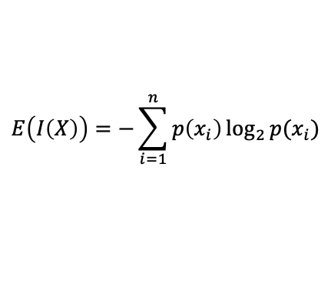
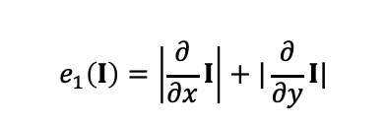

Energy Function
Energy function is used to determine the importance of each pixel.
A pixel with high energy value is regrarded as an important pixel.
We have tried $L_{1}$-norm of gradient and entropy.
$L_{1}$-norm of gradient
entropy
$$e_{1}\left(I\right)=\left|\frac{∂}{∂x}I\right|+|\frac{∂}{∂y}I|$$
$$E\left(I\left(X\right)\right)=−\sum_{i=1}^{n}{p\left(x_{i}\right)\log_{2}{p(x_{i})}}$$

Slide 13
Find out a Seam - Background
Example: reduce the width of an image.
To preserve energy of an image, we would like to remove pixels with low energy values.
[Remove_pix] Remove low energy pixels from each row? zig-zag effect
[Remove_col] Remove columns with the lowest energy value ? not continuous
[Crop] Cropping (a sub-window that contains the highest energy)? sacrifice the content

Slide 14
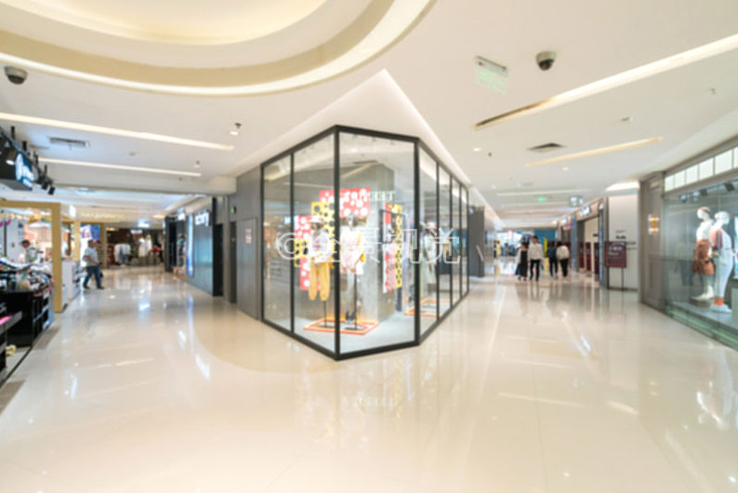
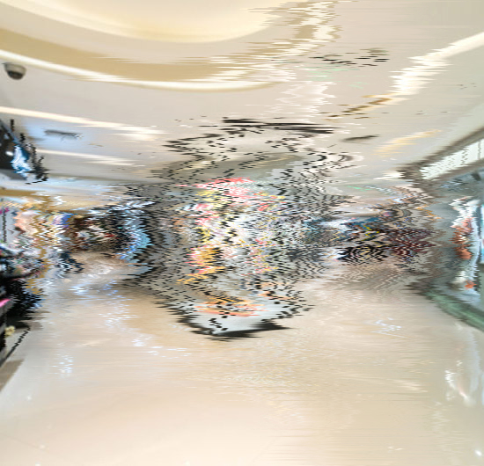
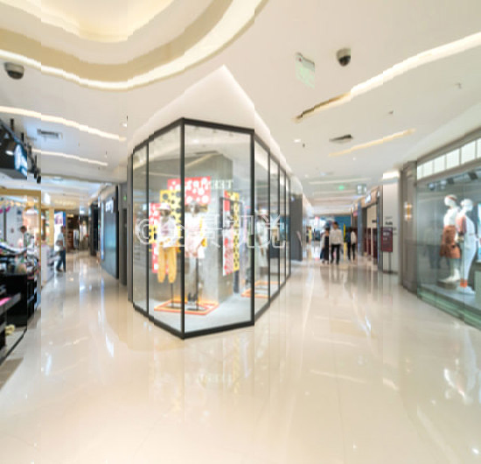
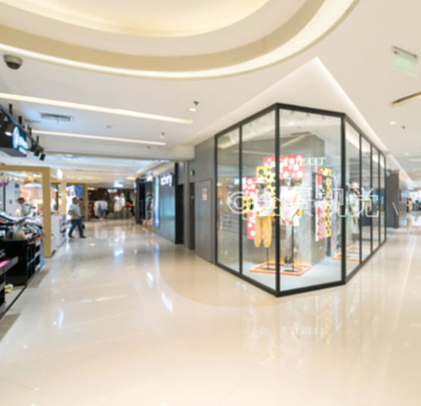
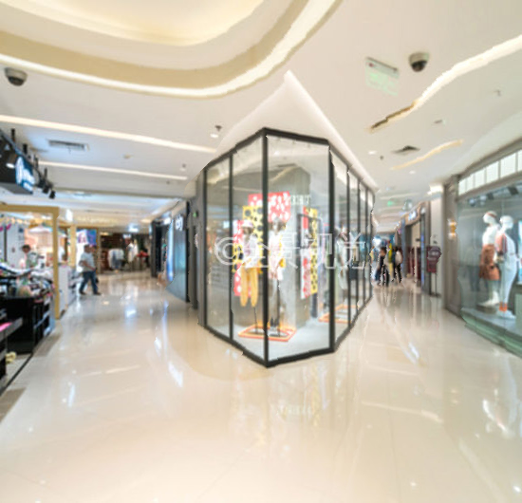
Find out a Seam - Background
Original image
Remove_pix
Remove_col
Crop
Seam carving

Slide 15
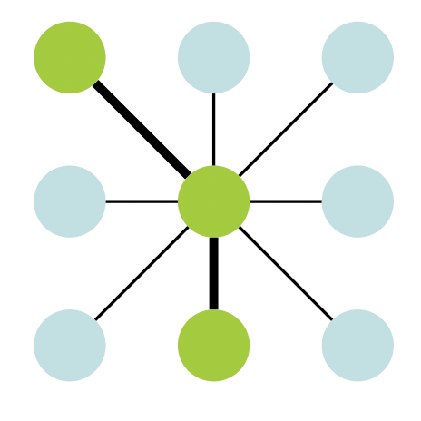
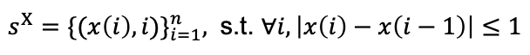
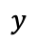
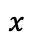
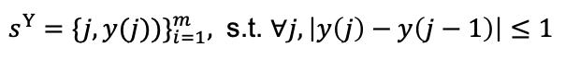
Find out a Seam - Definition
To preserve both energy and visual coherence, we need “seam”.
Seam is a 8-connected path.
Minimize the cost of a seam by dynammic programming.
$$x$$
Vertical seam:
$s^{X}={\{(x\left(i\right), i)\}}_{i=1}^{n},$ s.t. $∀i, \left|x\left(i\right)−x\left(i−1\right)\right|≤1$
Horizontal seam:
$s^{Y}={\{j, y(j))\}}_{i=1}^{m},$ s.t. $∀j, \left|y\left(j\right)−y\left(j−1\right)\right|≤1$
$$y$$
Vertical seam:
$$M\left(i,j\right)=e\left(i,j\right)+\min{(M\left(i−1,j−1\right), M\left(i−1,j\right),M(i−1,j+1))}$$
Horizontal seam:
$$M\left(i,j\right)=e\left(i,j\right)+\min{(M\left(i−1,j−1\right), M\left(i,j−1\right),M(i+1,j−1))}$$

Slide 16
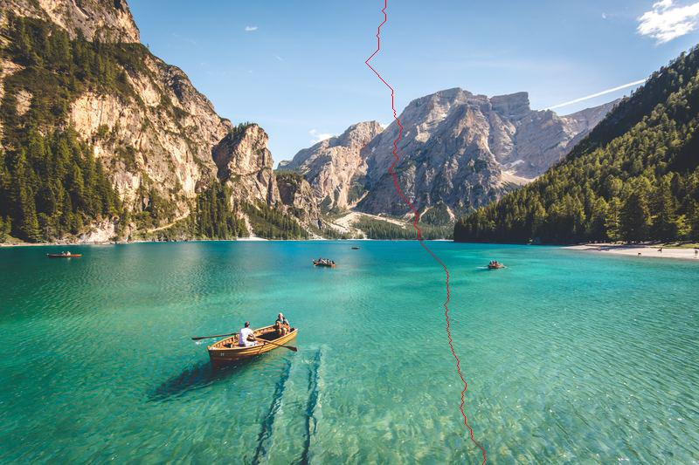
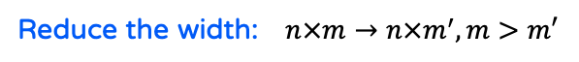

Image Reduction from One Dimension
Image reduction from one dimension.
Repeat the following steps until achieving our target.
Reduce the width: $n×m→n×m^{′}, m>m′$
Reduce the height: $n×m→n^{′}×m, n>n′$
Step 1: Obtain energy values of all pixels.
Step 2: Find a seam with the lowest cost.
(width: vertical, height: horizontal)
Step 3: Remove the seam from an image.

Slide 17

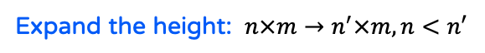
Image Insertion from One Dimension
Image insertion from one dimension.
There are three methods to insert seams.
Expand the width: $n×m→n×m^{′}, m<m′$
Expand the height: $n×m→n^{′}×m, n<n′$
Method 1: Insert one by one.
Method 2: Insert all seams in one time.
Method 3: Insert seams in batches.

Slide 18
Image Insertion from One Dimension
[Insert One by one] Repeat the following steps until achieving our target.
Problem: stretching artifact by choosing the same seam.
Step 1: Find a seam to be removed from the image.
(width: vertical, height: horizontal)
Step 2: Insert the seam back to the image.
Step 3: Duplicate the seam by averaging it with its left and right neighbors.

Slide 19
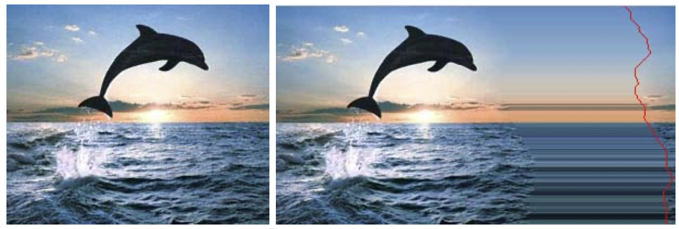
Image Insertion from One Dimension
‘’Insert one by one’’ may create a stretching artifact by choosing the same seam.

Slide 20
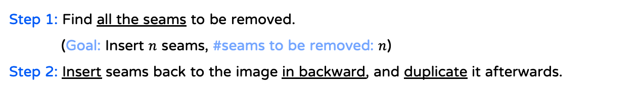
Image Insertion from One Dimension
[Insert all seams in one time]
Problem: Duplicates all the seams in an image is equivalent to standard scaling.
Step 1: Find all the seams to be removed.
(Goal: Insert $n$ seams, #seams to be removed: $n$)
Step 2: Insert seams back to the image in backward, and duplicate it afterwards.
50% enlargement

Slide 21
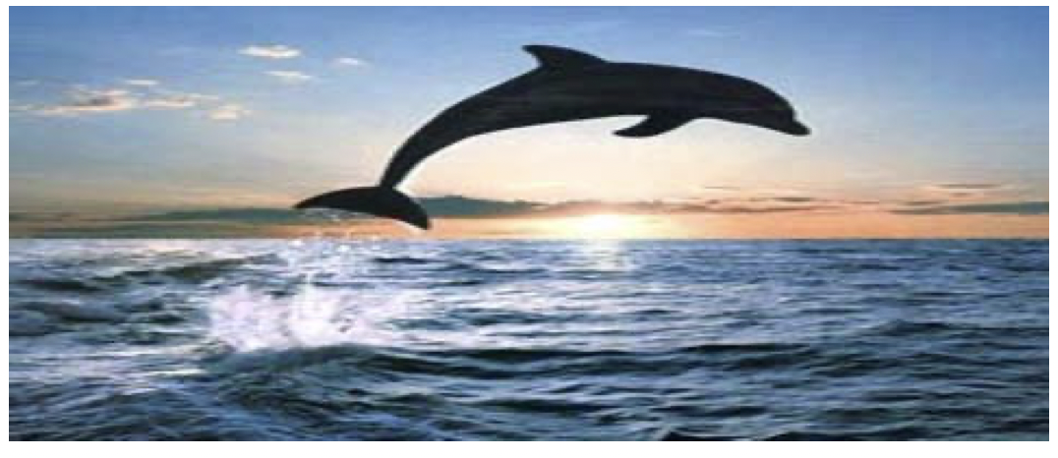
Image Insertion from One Dimension
“Insert all seams in one time’’ may choose all the seams in an image, which is equivalent to standard scaling.

Slide 22
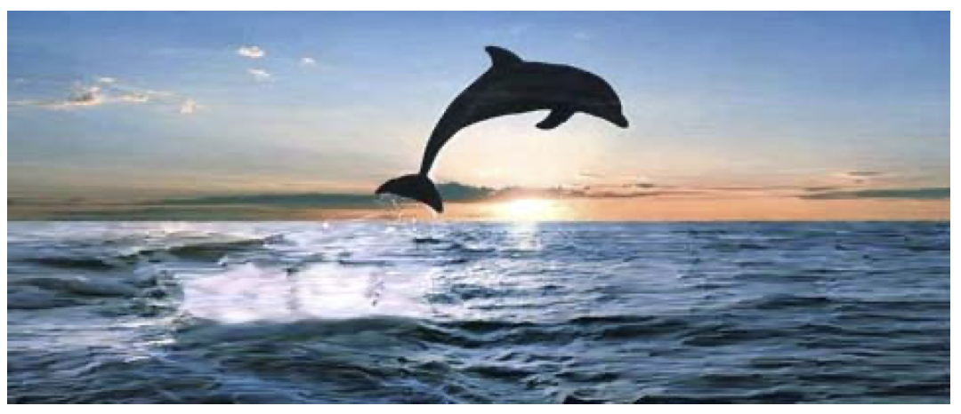
Image Insertion from One Dimension
[Insert seams in batches]
Break the process of “Insert all seams in one time” into several steps.

Slide 23


Image Retargeting from Two Dimensions
Image retargeting from two dimensions.
We propose the new method.
$$n×m→n′×m^{′}$$
Paper: Horizontal seams + vertical seams $→$ order is the matter. [Not yet]
Ours: Proportional scaling + seam removal.

Slide 24
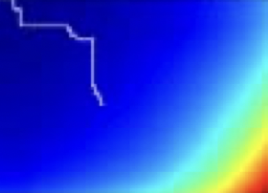
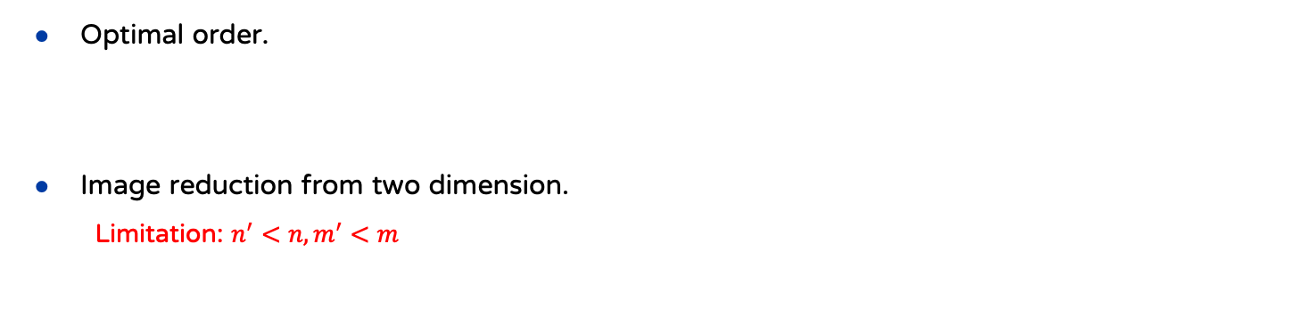
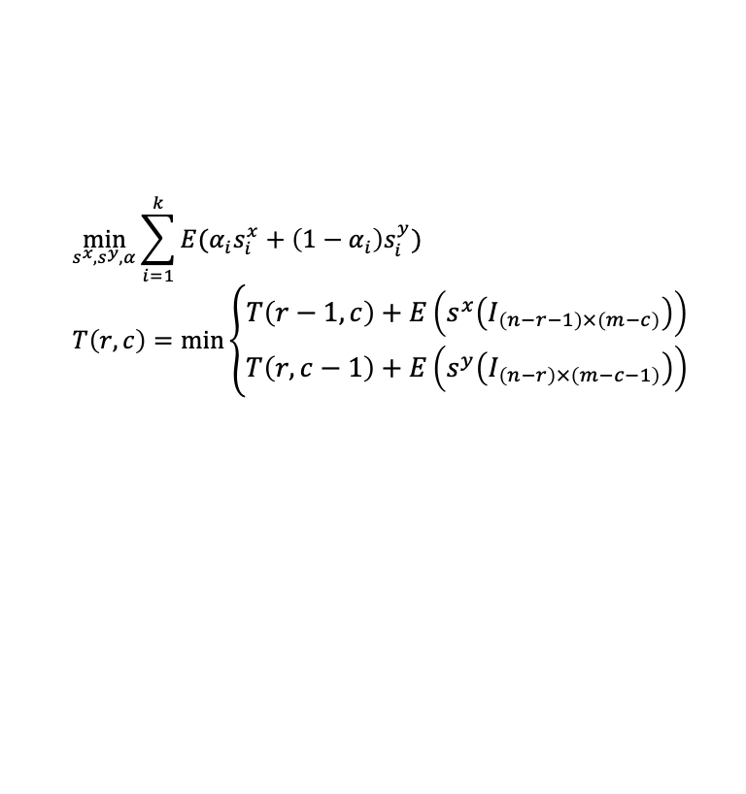
Image Retargeting from Two Dimensions - Author
Optimal order.
Image reduction from two dimension.
Limitation: $n^{′}<n, m^{′}<m$
Vertical first? Horizontal first? Alternate between the two?
$$\min_{s^{x}, s^{y}, α}{\sum_{i=1}^{k}{E(α_{i}s_{i}^{x}+\left(1−α_{i}\right)s_{i}^{y})}}$$
$$T\left(r,c\right)=\min\left\{\begin{aligned}T\left(r−1,c\right)+E\left(s^{x}\left(I_{\left(n−r−1\right)×\left(m−c\right)}\right)\right) \\ T\left(r,c−1\right)+E\left(s^{y}\left(I_{\left(n−r\right)×\left(m−c−1\right)}\right)\right)\end{aligned}\right.$$

Slide 25
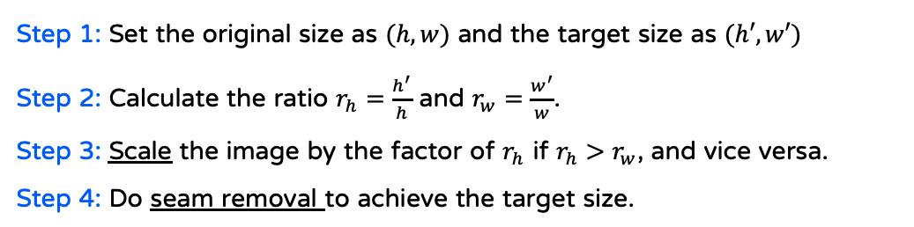
Image Retargeting from Two Dimensions - Ours
Image retargeting from two dimensions.
Advantages.
Step 1: Set the original size as $(h, w)$ and the target size as $(h′, w′)$
Step 2: Calculate the ratio $r_{h}=\frac{h^{′}}{h}$ and $r_{w}=\frac{w^{′}}{w}$.
Step 3: Scale the image by the factor of $r_{h}$ if $r_{h}>r_{w}$, and vice versa.
Step 4: Do seam removal to achieve the target size.
Easier ☺.
No limitation: Apart from image reduction, we can also do enlargement.

Slide 26
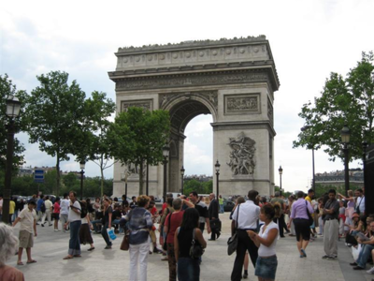
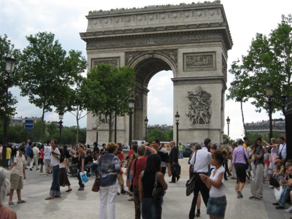
Content Amplification
Content amplification.
Step 1: Do proportional scaling to enlarge an image.
Step 2: Apply seam removal on the image to carve the image back to its original size.

Slide 27
Object Removal
Object removal
Step 1: Mark the target object to be removed.
Step 2: Give the marked pixels low enough energy values, so that they tend to be removed.
This step should be done in every cycle of seam removal.
Step 3: Do seam removal until all marked pixels are gone.
The orientation is set by user.
Step 4: Do seam insertion until the image back to its original size.

Slide 28
05
Results

Slide 29
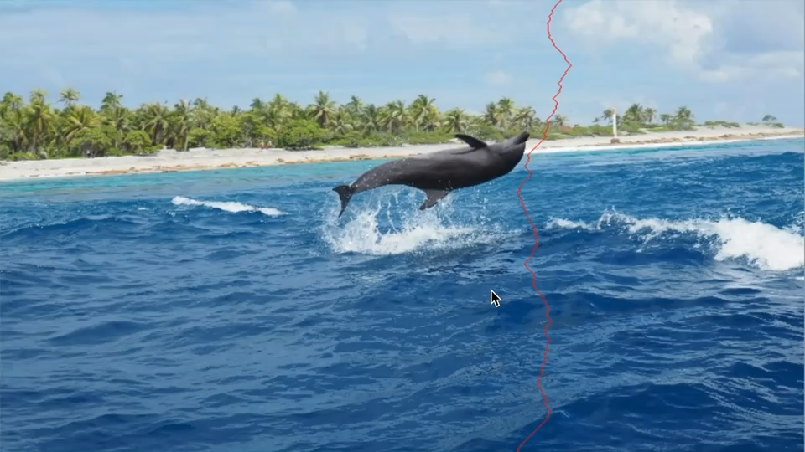
Image Reduction from One Dimension

Slide 30
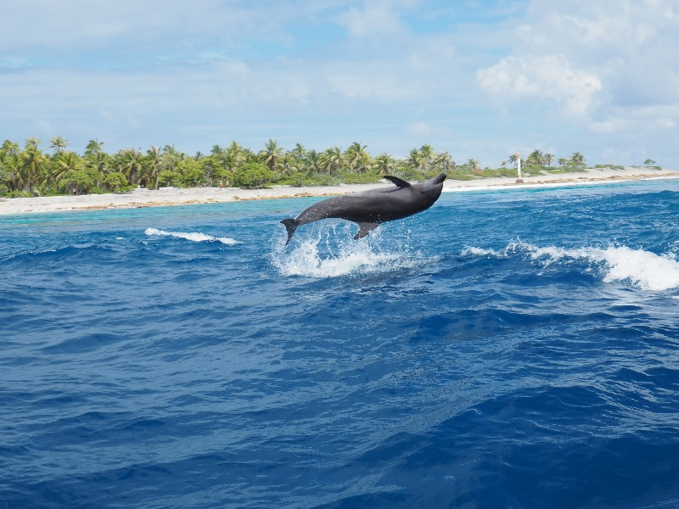
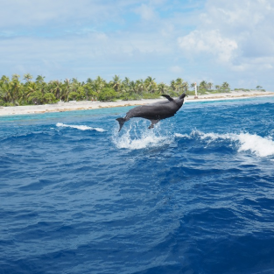
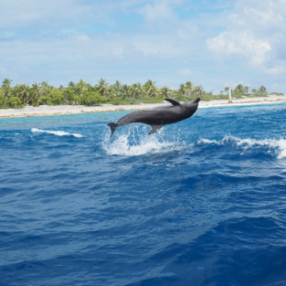
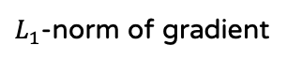
Image Reduction from One Dimension
The dolphin looks good under both energy functions. However, they show different effect!
Original image
$L_{1}$-norm of gradient
Entropy

Slide 31
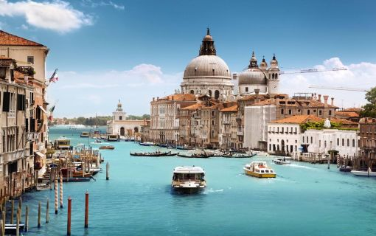
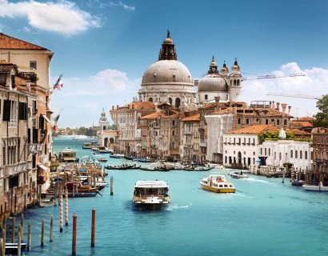
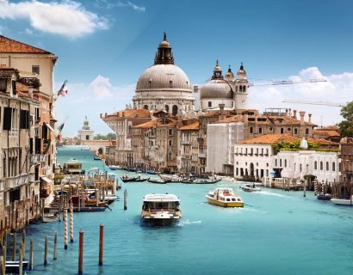
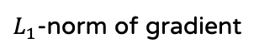
Image Reduction from One Dimension
Noticeable artifacts: the unnatural variation of light and shadow.
Original image
$L_{1}$-norm of gradient
Entropy

Slide 32
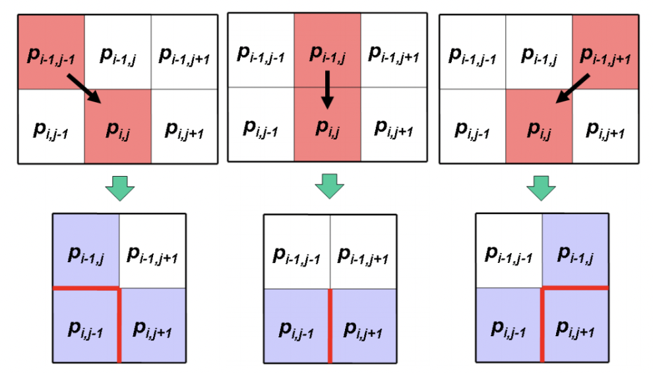
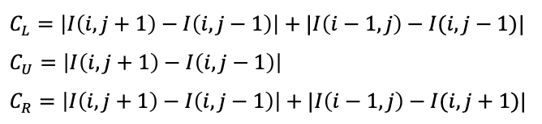
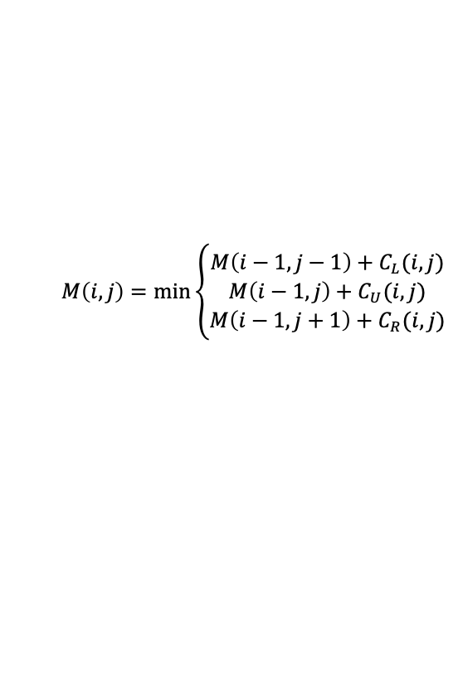
Image Reduction from One Dimension
Forward enregy.
$$M\left(i,j\right)=\min\left\{\begin{aligned}M\left(i−1, j−1\right)+C_{L}(i, j) \\ M\left(i−1, j\right)+C_{U}(i, j) \\ M\left(i−1, j+1\right)+C_{R}(i, j)\end{aligned}\right.$$
$$C_{L}=\left|I\left(i, j+1\right)−I\left(i, j−1\right)\right|+|I\left(i−1, j\right)−I(i, j−1)|$$
$$C_{U}=\left|I\left(i, j+1\right)−I\left(i, j−1\right)\right|$$
$$C_{R}=\left|I\left(i, j+1\right)−I\left(i, j−1\right)\right|+|I\left(i−1, j\right)−I(i, j+1)|$$

Slide 33
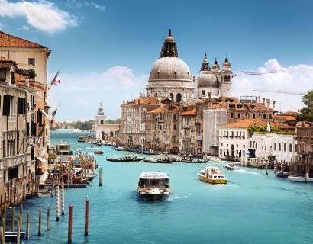
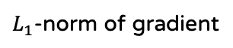
Image Reduction from One Dimension
“Forward energy” works better!
$L_{1}$-norm of gradient
Entropy
Forward energy

Slide 34
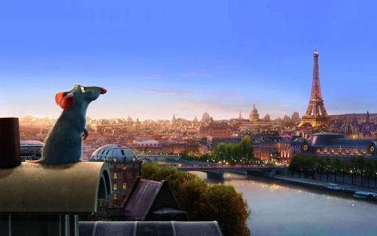
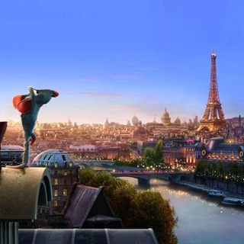
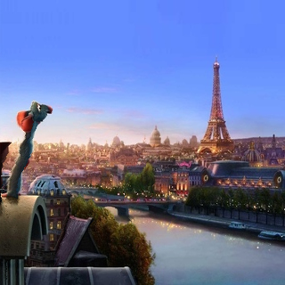
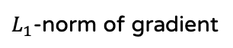
Image Reduction from One Dimension
The mouse is diminishing.
Original Image
$L_{1}$-norm of gradient
Forward energy

Slide 35
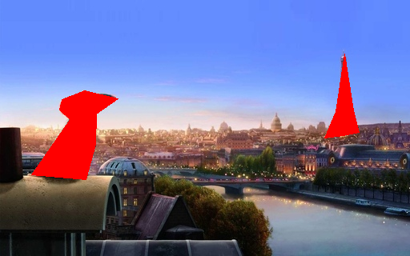
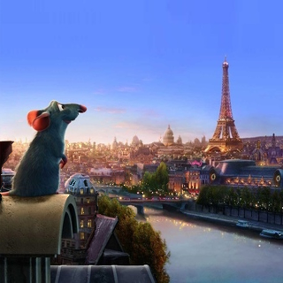
Image Reduction from One Dimension
Using a “protective mask” to protect important content of the image.
Give the red region “very high” energy value.
Protective mask
With mask
Without mask

Slide 36
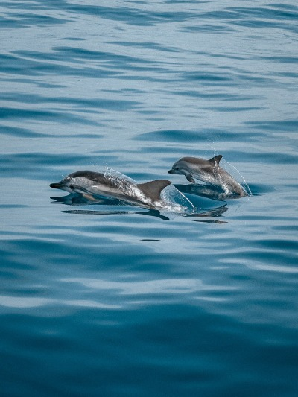
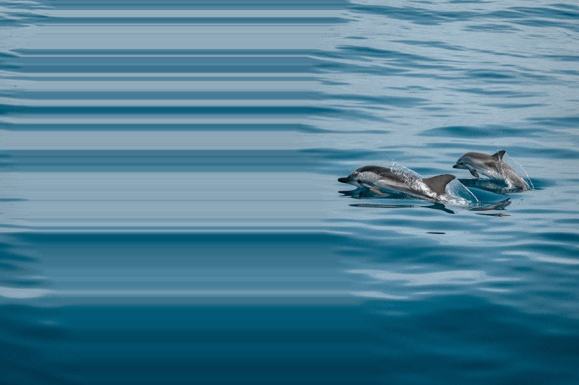
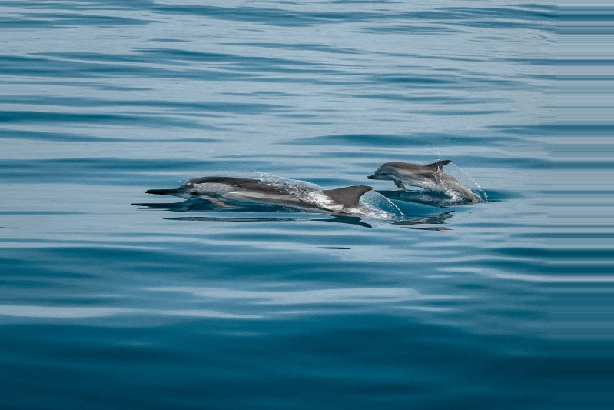
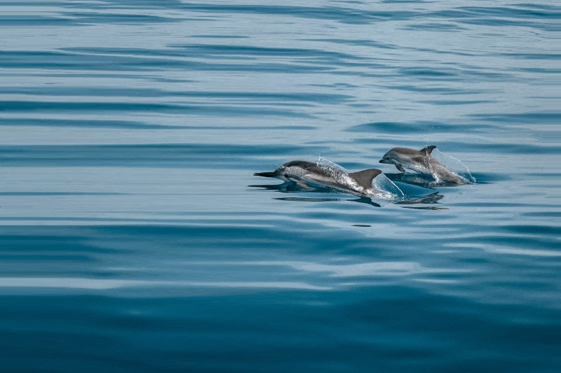
Image Insertion from One Dimension
Insert one by one vs. Insert all seams at one time vs. Insert seams in 5 batches.
stretching artifact
standard scaling
Original image
Insert one by one
Insert all seams at one time
Insert seams in 5 batches

Slide 37
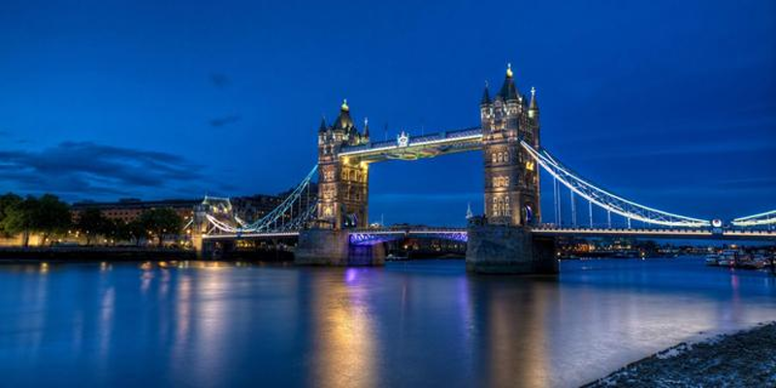


Image Retargeting from Two Dimensions
Our method supports us to do enlarge or shrink an image from two dimensions!
Original image (360, 640)
Reduction (250, 550)
Expansion (400, 800)

Slide 38




Content Amplification
They are different in the cloudy sky.
Original Image
$L_{1}$-norm of gradient
Forward energy

Slide 39


Object Removal
Define a “mask”.
Give the blue region “very low” energy value.
Original image
Image with a mask

Slide 40




Object Removal
Orientation does great impact on the result.
There are some noticeable artifacts in the image.
Improvement: insert the seams around masks. [Not yet]
Remove horizontally
Remove vertically

Slide 41
06
References

Slide 42
References
Avidan, Shai, and Ariel Shamir. "Seam carving for content-aware image resizing." ACM SIGGRAPH 2007 papers. 2007. 10-es.
Rubinstein, Michael, Ariel Shamir, and Shai Avidan. "Improved seam carving for video retargeting." ACM transactions on graphics (TOG) 27.3 (2008): 1-9.

Slide 43
Thank You

